Slide 1
Longitudinal Waves
28th september 2020

Slide 2
Sound wave in gases
In deriving the wave equation for the longitudinal wave, , let consider a fixed mass of gas in a volume.
Under the influence of the longitudinal or sound wave
Disturbed state parameters
Equilibrium state parameters
Notes:
p is excess pressure
v is volume difference

Slide 3
Typical changes in the medium due to sound waves
The fractional volume (dilatation):
The fractional change of density (condensation):
The maximum pressure amplitude for ordinary sound wave :
For a fixed mass of gas,
This gives to a very close approximation.
Notes:
Atmospheric pressure = 1.01 x 10^5 Pa

Slide 4

This factor indicates how pressure is changed as the distance changes
https://en.wikipedia.org/wiki/Longitudinal_wave
Notes:
แนวคิดทำนองเดียวกับการกระจัดในแนวตั้งฉากของเชือก ที่ ณ ตำแหน่งเชือก x มีการกระจัดในแนวแกน y ณ เวลา t เป็น y(x,t) ในขณะที่การกระจัดในแนวแกน y ณ ตำแหน่ง x + dx เป็น
y(x+dx,t)
Δη คือ ความหนาของ thickness ที่เพิ่มขึ้น

Slide 5
The wave equation of sound wave in gas
Layer x
Layer x+Δx
When there is no disturbance, the volume of the medium under interest is V = AΔx. For a unit cross section, V = Δx.
When there is a sound wave disturbance at time t, the particles in the layer x are displaced a distance η₁ = η(x, t)
And the particles in the layer x + Δx are displaced a distance
η₂ = η(x+Δx, t)
Three possible changes of volume may be observed :
(1) η₁ = η₂ : a constant volume shifted to the right
(2) η₁ < η₂ : an increased volume shifted to the right
(3) η₁ > η₂ : a decreased volume shifted to the right
Thin element of gas of unit cross-section and thickness Δx displaced and amount η under the influence of a pressure difference.
Notes:
A = unit cross sectional area

Slide 6
The increase of the element thickness Δη can be written as
This can be written in the derivative form meaning “the change of η (displacement) with respect to the change of x (distance)” as
Therefore, the increase in the thickness Δx of the element of unit cross section is
And
Longitudinal strain
Notes:
Don’t for get Δη is the increase of the element thickness

Slide 7
The wave equation of sound wave in gas (contd.)
The medium is deformed because the pressures along the x-axis on either side of the thin element are not in balance. The net force acting on the gas element is given by
Note : (1) p is the excess pressure or pressure change.
(2) the unit area cross section is used in this study

Slide 8
The wave equation of sound wave in gas (contd.)
According to the Newton’s 2nd Law,
The pressure change p can be written in terms of displacement η when using the bulk modulus B_{a} (=-VdP/dV) under the condition of the adiabatic process (Laplace’s idea).
∴p = - B_{a}(dV/V) = -B_{a}(v/V₀) = -B_{a}δ = -B_{a}(∂η/∂x)
This gives
This can be expressed as a final form of the wave equation as
From slide No. 6
Where B_{a} = γP representing the elastic property of the gas and c is the speed of sound in gas.
Notes:
อย่าลืมว่า จริง ๆ แล้วสมการในบรรทัดแรกถูกคูณด้วยพื้นที่ เพื่อทำให้ทางซ้ายมือของสมการเป็น force และทางขวามือเป็นผลคูณระหว่างมวลและความเร่ง
แต่ในที่นี้พื้นที่เป็น unit area
Laplace provided a correction for Newton’s formula. He assumed that, the process of compression and rarefaction occur very fast and no exchange of heat takes place. Thus, the temperature doesn’t remain constant and the propagation of sound in gas is an adiabatic process.
เหตุผลที่พิจารณาว่าเป็น adiabatic process เนื่องจาก พิจารณาว่าการเปลี่ยนแปลงความดันเกิดขึ้นอย่างรวดเร็วจนทำให้ไม่มีการถ่ายเทความร้อนระหว่างส่วนที่เกิด compression และ rarefaction
ถ้ามีการถ่ายเทความร้อนทันจะมีผลทำให้เกิด diffusion และการสูญเสียพลังงาน

Slide 9
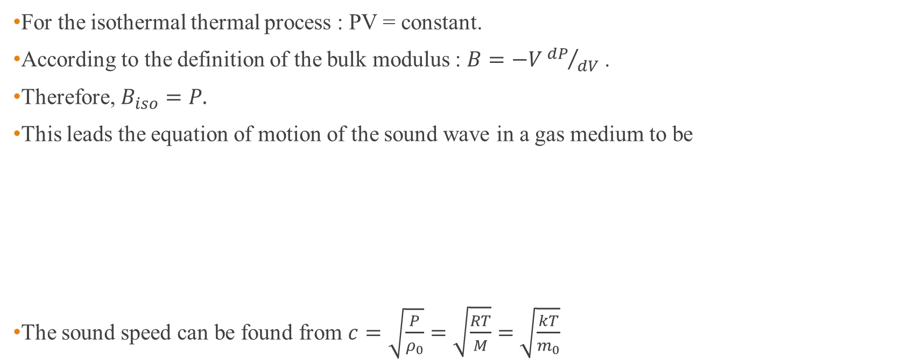
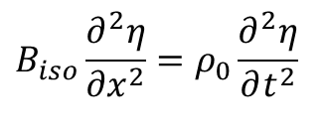

What if the sound medium obeys the isothermal process? (Newton’s idea)
For the isothermal thermal process : PV = constant.
According to the definition of the bulk modulus : $B=−V{dP}/{dV}$ .
Therefore, $B_{iso}=P.$
This leads the equation of motion of the sound wave in a gas medium to be
The sound speed can be found from $c=\sqrt{\frac{P}{ρ_{0}}}=\sqrt{\frac{RT}{M}}=$ $\sqrt{\frac{kT}{m_{0}}}$
$$B_{iso}\frac{∂^{2}η}{∂x^{2}}=ρ_{0}\frac{∂^{2}η}{∂t^{2}}$$
$$\frac{∂^{2}η}{∂x^{2}}=\frac{ρ_{0}}{P}\frac{∂^{2}η}{∂t^{2}}=\frac{1}{c^{2}}\frac{∂^{2}η}{∂t^{2}}$$
M =molecular weight
k = R/N
N = Avogadro’s number
m0 = mass of an individual molecule
Notes:
According to Newton, when sound waves propagate in air, compression and rarefaction are formed. He assumed that the process is very slow and the heat produced during compression is given to surrounding and heat loss during compression is gained from surrounding. So the temperature remains constant and sound waves propagate through an isothermal process.

Slide 10
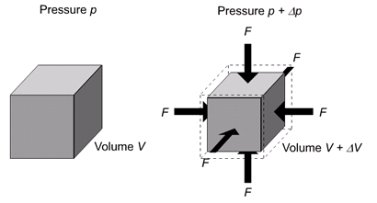
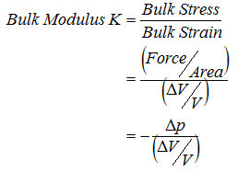
Bulk modulus
Bulk Modulus Review
The Bulk Modulus tells us just how compressible materials are.
Pressure increases,
Volume decreases
This minus sign makes a positive bulk modulus.
http://www.spaceflight.esa.int/impress/text/education/Mechanical%20Properties/MoreModuli.html
Notes:
ค่าส่วนกลับของ bulk modulus คือ compressibility

Slide 11
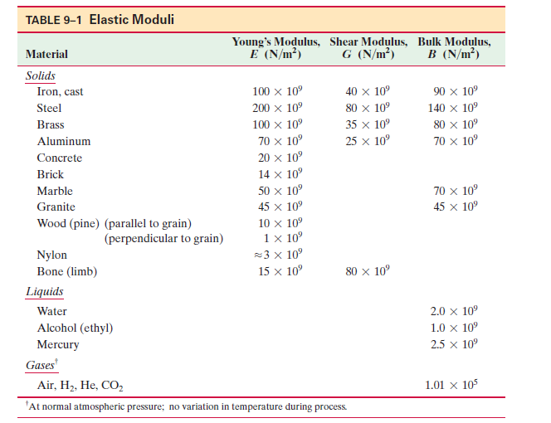
Example 1 : Bulk modulus of water
Bulk Modulus Review
Compute the bulk modulus of water from the following data:
Initial volume = 100.5 l., Final volume = 100 l., Pressure increase 100.0 atm (1 atm = 1.013 x 10⁵ Pa)
https://iitsat.com/compute-the-bulk-modulus-of-water-from-the-following-data-initial-volume-100-0-litre-pressure-increase-100-0-atm-1-atm-1-013-x105-pa-final-volume-100-5-l/
Notes:
1 litre = 1000 cm^-3

Slide 12
Example 2 : What is the speed of sound wave at sea level?
Recall the speed of sound wave :
For air sea level, the pressure is ……………. and the density of air is………….
And γ = 1.4. This gives c =……………….
The speed of sound wave is proportional to the pressure P and inversely proportional to density ρ₀ .
Calculate the speed of sound wave using the Newtown’s formula!
https://www.sciencetopia.net/physics/velocity-sound-gas-newton-formula
Notes:
Air pressure at sea level 1.01 x 10^5 Pa
Air density at sea level = 1.3 kg/m^3
C = 330 m/s

Slide 13
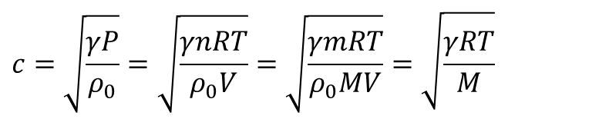
Practical formula for speed of sound wave in dry air as a function of temperature
$$c=\sqrt{\frac{γP}{ρ_{0}}}=\sqrt{\frac{γnRT}{ρ_{0}V}}=\sqrt{\frac{γmRT}{ρ_{0}MV}}=\sqrt{\frac{γRT}{M}}$$
According to
Substitute
The speed of sound wave in dry air can be written as
Notes:
γair = 1.4
Both formula give v = 346.5 m/s@25C
To solve this problem, we can calculate the speed of sound wave from direct formula shown in the slide.
Alternatively we can just substitute the temperature in the 331.6 + 0.606t.
Both ways will give you the same answer!

Slide 14
Phase relationships
For a travelling wave propagating in the positive x-direction
For a travelling wave propagating in the negative x-direction
η
From slide No. 6
From slide No. 8
η
Notes:
i = e^iπ/2
Notice that pressure and displacement always has 90⁰ out of phase.

Slide 15
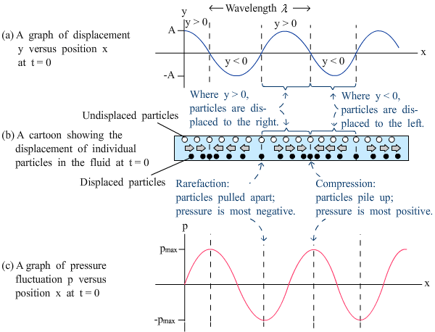
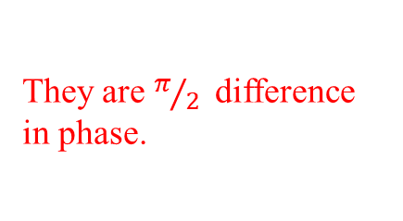
Pressure and displacement in air column
Notice the phase difference between the displacement and pressure
They are $π/2$difference in phase.
http://ap.polyu.edu.hk/apahthua/College%20Physics/ch16_1.html

Slide 16
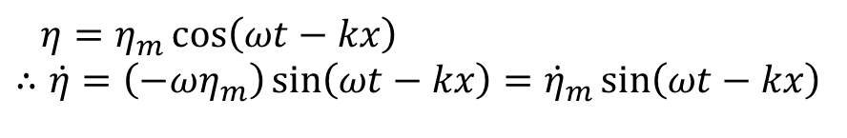
Energy distribution in travelling sound waves
Determine the average values of the kinetic and potential energy density in the sound wave.
Each element has a kinetic energy per unit cross section given by
With a displacement
The space average kinetic energy density (kinetic energy per volume) is written as
.
This gives
$$η=η_{m}\cos\left(ωt−kx\right) \\ ∴\dot{η}=\left(−ωη_{m}\right)\sin\left(ωt−kx\right)={\dot{η}}_{m}\sin\left(ωt−kx\right)$$
Notes:
จริง ๆ แล้ว kinetic energy per unit cross section ก็คือ energy density แต่เนื่องจาก เราใช้ unit crosssection
Kinetic energy density = kinetic energy per unit volume
Potential energy density = potential energy per unit volume
เมื่อพิจารณา kinetic energy per volume เราก็จะหา ΔKE ด้วย volume ซึ่งคือผลคูณระหว่าง cross section กับ element thickness Δx
เนื่องจาก cross section คือ unit cross section เมื่อทำให้เป็น volume ต้องคูณด้วย Δx จึงทำให้ ไม่มีเทอม Δx เหลือในส่วนของ kinetic energy density

Slide 17
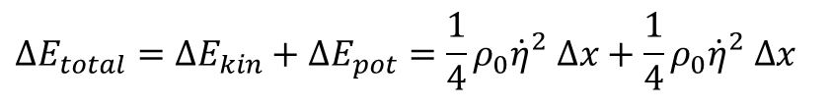
Energy distribution in travelling sound waves
The average potential energy density (potential energy per volume) is written in a similar for as
In fact, the total energy content of sound wave in an element Δx is given as
This indicates that the element possess maximum (or minimum) potential and kinetic energy at the same time.
$$ΔE_{total}=ΔE_{kin}+ΔE_{pot}=\frac{1}{4}ρ_{0}{\dot{η}}_{}^{2}Δx+\frac{1}{4}ρ_{0}{\dot{η}}_{}^{2}Δx$$
At points of no velocity, there is no compression and the particles do not possess energy at these points.
At points of maximum velocity, there is compression and the particles possess maximum energy.
Notes:
Kinetic energy density = kinetic energy per unit volume
Potential energy density = potential energy per unit volume
KE and PE are equal and vary in a similar manner with time and distance.
This is true in non dispersive medium.

Slide 18
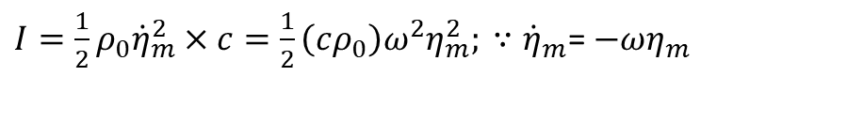
Intensity of sound waves
power
Intensity is the measure of the energy flux.
Energy flux =the rate of energy crossing unit area
= total energy density × wave velocity c
Therefore, the intensity is written as
Dynamic range of the audible sound intensity (Sound intensity level) is between 0 dB to 120 dB.
The lowest and the highest intensity levels are based on normal sound waves range in intensity between 10⁻¹² W/m² and 1 W/m²
$I=\frac{1}{2}ρ_{0}{\dot{η}}_{m}^{2}×c=\frac{1}{2}\left(cρ_{0}\right)ω^{2}η_{m}^{2}; ∵{\dot{η}}_{m}$= $−ωη_{m}$
From slide No. 16
Notes:
Unit of intensity or energy flux is W/m2
Dynamic range = an audible range from minimum to maximum

Slide 19
Example 3 : sound intensity level
A point source of sound emits 50,000 joules of sound energy every 20 seconds. At a distance 100 meters from the source, what is the intensity of the sound (in decibels), if no energy is lost in the intervening space?
Notes:
103 dB

Slide 20
Example 4 : displacement amplitude
Barely audible sound in air has an intensity of 10⁻¹² w/m².
Determine the displacement amplitude of an air molecule for sound at this level at 500 Hz in an ambient temperature of 25⁰C.
Notes:
C = 330 m/s
= 1.3 kg/m^3
I0 10^-12 W/m^2

Slide 21
Specific Acoustic Impedance
Specific Acoustic Impedance = excess pressure/particle velocity =
For a wave in a positive x-direction:
For a wave in a negative x-direction :
The unit is given as kg m⁻² s⁻¹.
Specific acoustic impedances of air, water and steel in the unit are 400, 1.45 x 10⁶ and 3.9 x 10⁷ kg m⁻² s⁻¹, respectively.
Referring to slide No. 14
Notes:
ถ้าดูจากนิยามของ specific acoustic impedance แล้ว เราบอกได้ว่า เป็นค่าที่บอกเรา ในหนึ่งหน่วยอัตราเร็วของ particle ต้องใช้ excess pressure เท่าใด
ดังนั้นถ้าเราเทียบ specific acoustic impedance ของ สองตัวกลาง ตัวกลางหนึ่งมีค่า specific acoustic impedance มากกว่าอีกตัวกลางหนึ่ง
แสดงว่าตัวกลางแรกต้านการเปลี่ยนแปลงมากกว่าตัวกลางที่สอง

Slide 22
The importance of the specific acoustic impedance
The determination of acoustic transmission and reflection at the boundary of two materials having different specific acoustic impedances.
When a sound wave meets a boundary between two media of different specific acoustic impedances, two boundary conditions must be met.
(1) the continuity of particle velocity
(2) the continuity of the acoustic excess pressure p
Physically, this ensures that the two media are in complete contact everywhere across the boundary.

Slide 23
Reflection and transmission coefficients
According to the boundary conditions
Because (from slide #21) and substituting corresponding excess pressures into above equations and determine both coefficients.
Reflection and transmission coefficients of particle velocity
Reflection and transmission coefficients of pressure
Notes:
สังเกตว่าเป็นเหตุการณ์ normal incidence

Slide 24
Example 5 : boundary conditions

Slide 25
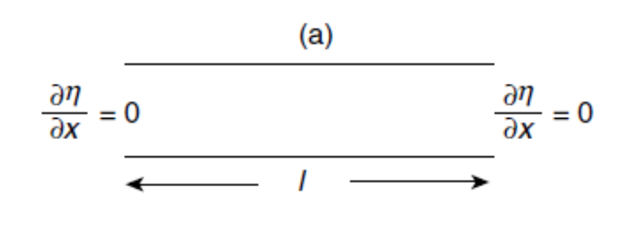
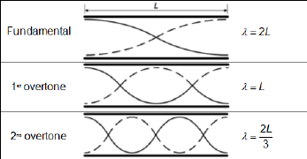
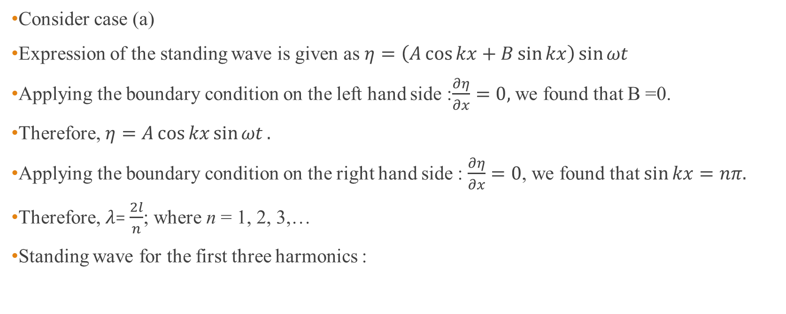
Solution
Consider case (a)
Expression of the standing wave is given as $η=\left(A\cos{kx+B\sin{kx}}\right)\sin{ωt}$
Applying the boundary condition on the left hand side :$\frac{∂η}{∂x}=0,$ we found that B =0.
Therefore, $η=A\cos{kx}\sin{ωt}.$
Applying the boundary condition on the right hand side : $\frac{∂η}{∂x}=0$, we found that $\sin{kx=nπ.}$
Therefore, $λ$= $\frac{2l}{n}$; where n = 1, 2, 3,…
Standing wave for the first three harmonics :
Your turn to try case (b)!
http://physics-ref.blogspot.com/2019/06/a-pipe-of-length-100-cm-is-open-at-both.html

Slide 26
Reflection and transmission of sound intensity
The intensity coefficients of reflection and transmission are given by
Note : the expressions are applied for normal incidence only.

Slide 27
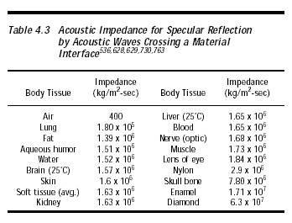
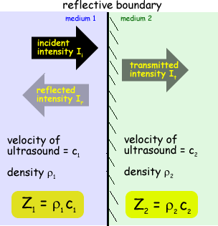

Acoustic impedance
Notice : a large difference between the impedance of air and skin
http://www.cyberphysics.co.uk/topics/medical/Ultrasound/reflectionUS.html
http://www.nanomedicine.com/NMI/Tables/4.3.jpg

Slide 28

Ultrasound coupling gel
From the table in the previous slide, a large difference between the impedance of air and skin can be seen.
Without a coupling gel, only a tiny power of ultrasound is sent through the body!
Recall,
When Z₁ = 400 kg/m²-sec and Z₂ = 1.6 x 10⁶ kg/m²-sec
The reflected intensity is about 99.95%!
$${\left(\frac{Z_{2}−Z_{1}}{Z_{2}+Z_{1}}\right)}^{2}$$
http://www.electrotherapy.org/modality/ultrasound-gels-and-coupling-agents

Slide 29
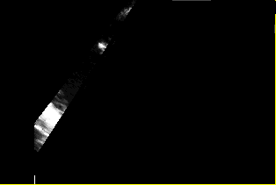
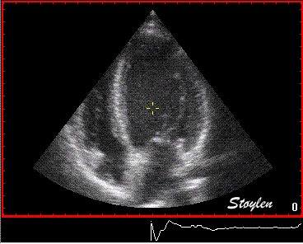
A sonogram from ultrasound scan
Notes:
B-Scans
B-scans can be used to take an image of a cross-section through the body. The transducer is swept across the area and the time taken for pulses to return is used to determine distances, which are plotted as a series of dots on the image. B-Scans will give two-dimensional information about the cross-section.

Slide 30
Example 6 : Reflection and transmission
Determine the percentage of energy reflection when sound waves are normally incident on a plane steel water interface.
Determine the percentage of energy transmission, if the waves are travelling in water and are normally incident on a plane water-ice interface.
(ρc values in kg m⁻² s⁻¹)
water = 1.43 x 10⁶
ice = 3.49 x 10⁶
steel = 3.8 x 10⁷
Notes:
86% สะท้อน, 82.3% ทะลุผ่าน

Slide 31
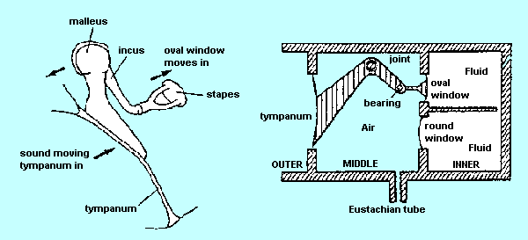
Example 7 : Impedance matching in ear
Tympanic membrane vibrations are transmitted through middle ear ossicles to the inner ear (cochlea) via the oval window.
The ossicles provide small amount of amplification, but their main role is impedance matching.
Two main mechanisms involved in the amplification are area ratio and lever action.
http://www.david.curtis.care4free.net/hearingrev.htm
Notes:
The ossicles (also called auditory ossicles) are three bones in either middle ear that are among the smallest bones in the human body.

Slide 32
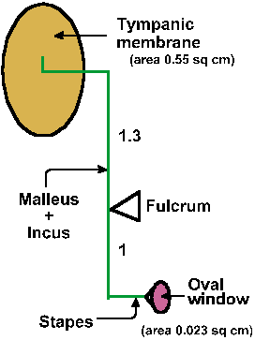
How the middle ear works
P1 : pressure on the tympanic membrane
P2 : pressure on the oval window
Schematic drawing of ossicle system to illustrate the lever arms and the position of the fulcrum. Relative areas of the tympanic membrane and the membrane of the oval window are shown.
http://michaeldmann.net/mann8.html
Notes:
The eardrum, which acts like a large piston, is mechanically coupled to the stapes, which acts like a small piston at the entrance to the inner ear. The ratio of the effective areas of the large eardrum (A1) to that of the base of the stapes in the entrance of oval windows (A2) is about 15 to 1. So that (A1/A2) increases the pressure by a factor of 15. 15 1 15 effective area of theoval windows effective area of the eardrum 2 1   
This gain combined with the lever gain of 1.3 results in a total gain of about 20. These factors produce a pressure P2 at the oval window that is about 20 times higher than the sound pressure P1 at the eardrum
From https://uomustansiriyah.edu.iq/media/lectures/3/3_2018_03_17!10_32_48_PM.pdf

Slide 33
Longitudinal Waves in a solid
The velocity of longitudinal waves in a solid depend upon the dimensions of the specimen in which the waves are travelling.
For a thin bar of finite cross section, the wave equation is composed of longitudinal wave from only longitudinal strain or axial strain and given as
In bulk solids, the wave equations are composed of longitudinal wave and transverse wave due to transverse strain.
Y = Young’s modulus, the ratio of the longitudinal stress in the bar to its longitudinal strain.

Slide 34
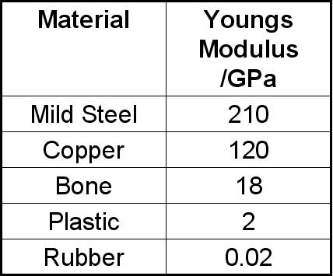
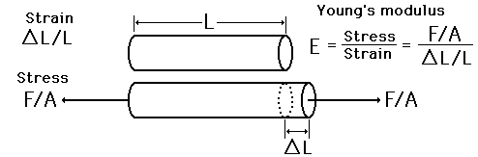
Young’s modulus
Young’s modulus review
Young’s Modulus is a vitally important number that describes how a material behaves under tension.
https://www.quora.com/Does-cold-working-change-Youngs-modulus
http://physicsnet.co.uk/a-level-physics-as-a2/materials/young-modulus/
Notes:
ค่า ยังโมดูลัสยิ่งสูงแสดงว่าต้องใช้แรงมาในการทำให้วัสดุยืดออก

Slide 35
Transverse wave and transverse velocity in a bulk solid
Because the bulk solid distorts laterally. This gives rise to a transverse wave.
The transverse shear strain is ∂β/∂x and the transverse shear stress is μ(∂β/∂x ); μ = shear modulus of rigidity.
The equation of transverse motion of the thin element dx is given by
summation of transverse shear stress = mass x acceleration
β = displacement in y direction and a function of both x and y.
∴Transverse velocity c = (μ/ρ)^{1/2}
Notes:
Shear แรงในแนวตัดขวาง
ใน bulk solid สามารถเกิดได้ทั้ง longitudinal และ transverse velocity

Slide 36
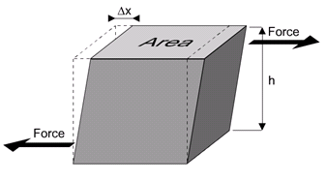
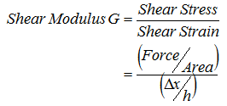
Shear Modulus or modulus of rigidity
Shear modulus review
The shearing force do not pass through the same point.
This result is that the profile of the object becomes distorted.
Shear modulus μ
http://www.spaceflight.esa.int/impress/text/education/Mechanical%20Properties/MoreModuli.html

Slide 37
Longitudinal wave velocity in a bulk solid
The effect of the transverse rigidity is to stiffen the solid and increase the elastic constant governing the propagation of longitudinal waves.
The longitudinal wave velocity becomes
Alternatively, ; B = bulk modulus
The longitudinal wave velocity for a bulk solid becomes
And recall the transverse wave velocity for a bulk solid,
Relationship between Poisson ratio σ and shear modulus μ

Slide 38
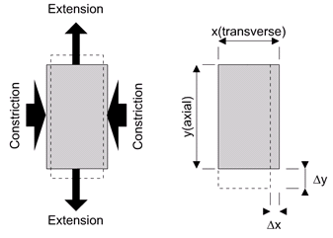
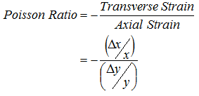
Poisson’s ratio
When a sample, such as a wire, is stretched then it gets a little thinner. The Poisson Ratio puts a number to this effect.
The axial direction is the direction of the applied force, be that tensional or compressive. The (two) transverse directions are at right angles to this.
If the sample is stretched then (usually) it will get thinner and so the Poisson Ratio is defined as
http://www.spaceflight.esa.int/impress/text/education/Mechanical%20Properties/MoreModuli.html
Notes:
Axial direction is defined by the direction of the applied force.

Slide 39
Example 8 : Poisson ratio for the earth
Near the surface of the earth, the longitudinal waves (P wave) have a velocity of 8 km/s and the transverse wave (S wave) travel at 4.45 km/s.
Calculate the Poisson ratio for the earth.
Notes:
σ = 0.276

Slide 40
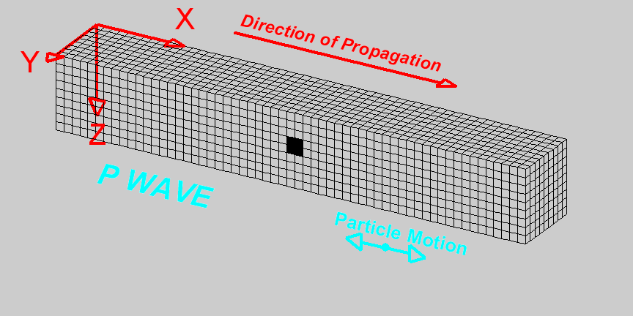
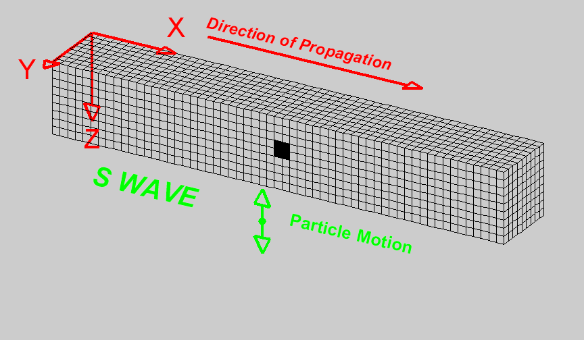
Seismic waves : body waves (P and S waves)
P-waves consists of the transmission of compressions and rarefraction of rock, similar to the propagation of the sound
S-waves, consists of wave propagation of shear, where the particles move in a direction perpendicular to the direction of propagation of the disturbance
https://web.ua.es/en/urs/disclosure/seismic-wave-propagation.html
Notes:
Seismic waves also include surface waves :i.e., Rayleigh and love waves

Slide 41
Homework #6

Slide 42
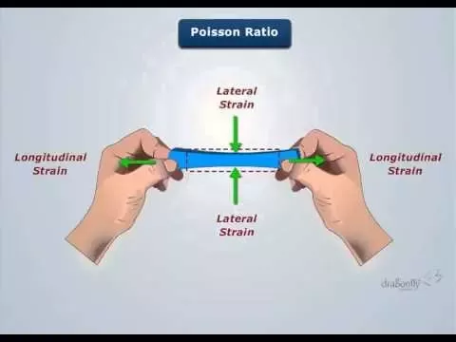
Poisson’s ratio
Strain : By how much times something elongated and shortened with respect to original dimension.
Longitudinal direction : Length wise direction, but here its considered the direction of pull.
Lateral direction :Direction perpendicular to longitudinal, here its considered the perpendicular direction with respect to the direction of pull.
Poisson’s effect: Material contracting or expanding in transverse direction when pulled or compressed in axial direction.
Longitudinal Strain : By how much times something elongated and shortened with respect to original dimension in direction of pull(pull is lengthwise).
Lateral/Transverse Strain : By how much times something elongated and shortened with respect to original dimension in perpendicular direction of pull
Poisson’s ratio is a material property describing the lateral strain with respect to the longitudinal stain.
https://www.quora.com/What-is-the-physical-significance-of-Poissons-ratio-with-respect-to-engineering-materials
Notes:
Strain : By how much times something elongated and shortened with respect to original dimension.
Longitudinal direction : Length wise direction, but here its considered the direction of pull.
Lateral direction :Direction perpendicular to Longitudinal direction(you can say breadth wise direction but i would recommend to not to use that term),here its considered the perpendicular direction with respect to the direction of pull.
Poisson’s effect: Material contracting or expanding in transverse direction when pulled or compressed in axial direction.
Longitudinal Strain : By how much times something elongated and shortened with respect to original dimension in direction of pull(pull is lengthwise).
Lateral/Transverse Strain : By how much times something elongated and shortened with respect to original dimension in perpendicular direction of pull

